Slide 1
IBM Rational Rhapsody Advanced Systems Training v7.5
Table and Matrix Views

Slide 2
Objectives
In this module you will learn:
  How Rhapsody handles tables and matrix views
  How to generate predefined SysML tables:
    Requirements Tables
    Allocation Tables
  How to define your own tables and matrixes
Notes:
Course Title - Instructor Notes - Arial Narrow 20pt
Module X - Module Title

Slide 3
Matrixes and tables overview
Tables and matrixes can be added to packages.
Tables and matrixes (views) must be based on table and matrix layouts.
  Layouts are the definition or template for the table/matrix.
  Views are instances of Layouts for a particular scope.
    The SysML Profile already has a Table and Matrix Layout defined.
  Tables and Matrixes are automatically generated from existing model content.
In the next few pages, you will learn how to use the predefined SysML layouts and define your own.
Notes:
Course Title - Instructor Notes - Arial Narrow 20pt
Module X - Module Title

Slide 4
IBM Rational Rhapsody Advanced Systems Training v7.5
Tables

Slide 5
Open a model
Launch Rhapsody.
From the menu:
  File > Open
Open the TableAndMatrixViews model.
Notes:
Course Title - Instructor Notes - Arial Narrow 20pt
Module X - Module Title

Slide 6
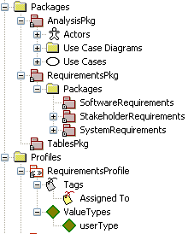
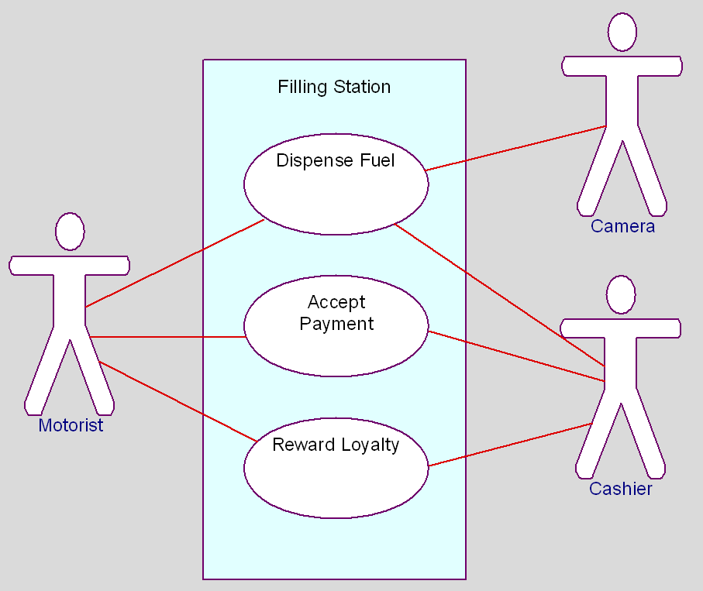
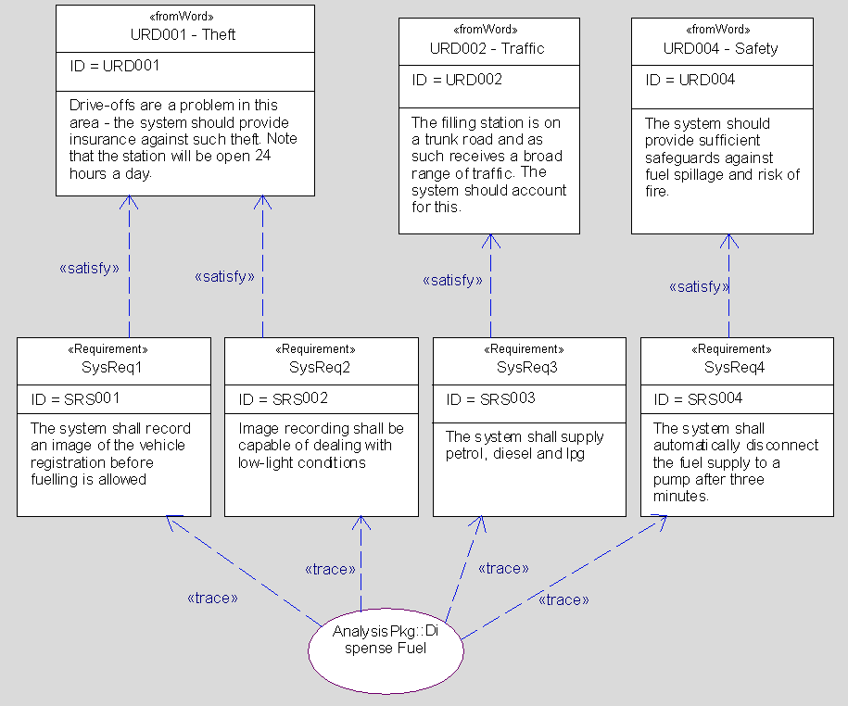
Model overview
Review the model and note that there are:
  Stakeholder Requirements
  System Requirements that satisfy the stakeholder Requirements
  Use Cases which trace to the system Requirements.
  Note also the use of a profile to add a tag to each requirement
Notes:
Course Title - Instructor Notes - Arial Narrow 20pt
Module X - Module Title

Slide 7
Adding a predefined SysML layout
SysML has two layouts already predefined:
  Allocation tables
  Requirements tables
Right-click TablesPkg:
  Select Add New → Requirements → Requirements Table
  Name it All Requirements
Notes:
Course Title - Instructor Notes - Arial Narrow 20pt
Module X - Module Title

Slide 8
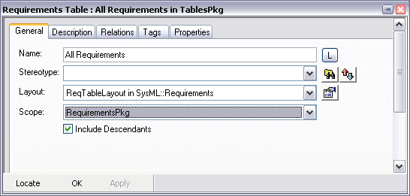
Requirements Table
Right-click the All Requirements Requirements Table
  Select Features
  Set the scope of the Table to the Requirements Package
    Ensure that Include Descendants is selected.
    Click OK.
Layout to use
(in this case predefined)
Scope of Table
Notes:
Course Title - Instructor Notes - Arial Narrow 20pt
Module X - Module Title

Slide 9
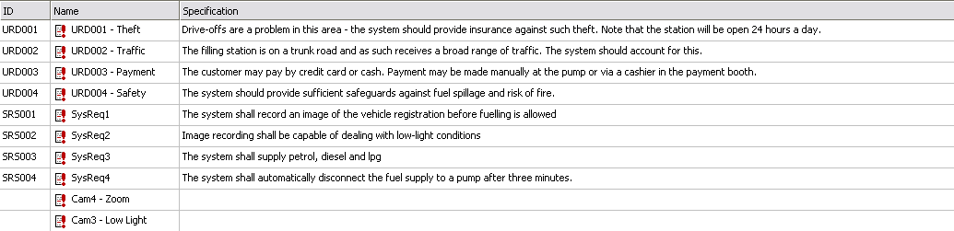
Open the table
Double-click the All Requirements Requirements Table in the browser to open it.
  You will find it in the TablesPkg
The predefined SysML layout uses ID, Name and Specification as its columns
Missing ID, Specification
Notes:
Course Title - Instructor Notes - Arial Narrow 20pt
Module X - Module Title

Slide 10
What can you do with Tables ?
Tables provide a more convenient view of textual information.
  Locate missing information
Use them for navigation.
  Each cell in the table is context sensitive
Use them to add new elements quickly
Tables can be printed.
Tables can be copied into other documents.
Notes:
Course Title - Instructor Notes - Arial Narrow 20pt
Module X - Module Title

Slide 11
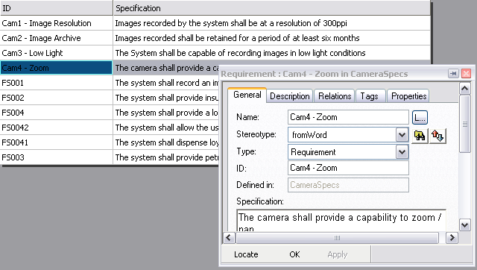
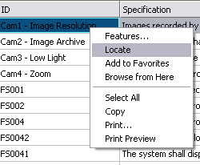
Navigating items using table views
Table view items are context sensitive.
  If the features view is open, selecting an item focuses the features view on that item.
Table items have a Context menu (including Locate).
Notes:
Course Title - Instructor Notes - Arial Narrow 20pt
Module X - Module Title

Slide 12
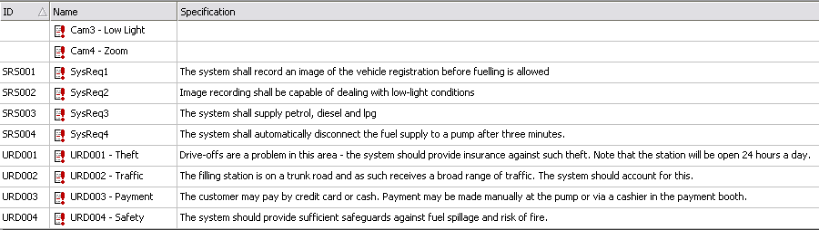
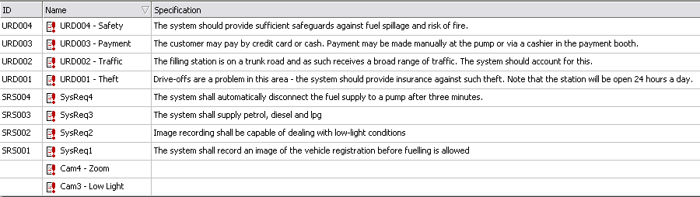
Sorting Table Views
Table views may be sorted by clicking the column heading.
Notes:
Course Title - Instructor Notes - Arial Narrow 20pt
Module X - Module Title

Slide 13
Copying table views - overview
If you have Microsoft Excel installed then you may want to try this (it is optional)
  To select the entire table:
    Press Ctrl+A.
    Right-click and select Select All.
  To copy the selection:
    Press Ctrl+C.
    Right-click and select Copy.
  Table views can be pasted directly into other documents including spreadsheets.
    Cells in the table become cells in a spreadsheet.
Notes:
Course Title - Instructor Notes - Arial Narrow 20pt
Module X - Module Title

Slide 14
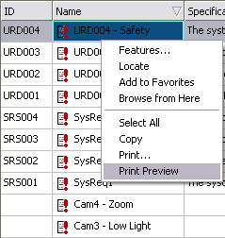
Printing
Table views may be directly printed / previewed from Rhapsody:
  This is dependant on your machine having a printer installed
Notes:
Course Title - Instructor Notes - Arial Narrow 20pt
Module X - Module Title

Slide 15
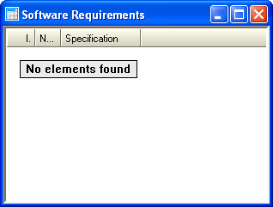

Using a Table View to add elements (1)
Right-click the RequirementTables category
  Select Add New Requirements Table.
  Name it Software Requirements.
  In the features view set the scope of the Table to the SoftwareRequirements
    Double-click the table to view it
    Note that the table is empty because the Software Requirements Package is empty

Slide 16
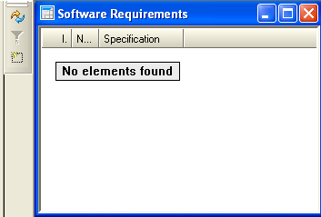
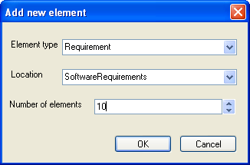
Using a Table View to add elements (2)
In the Table toolbar, select Add Model Element
  The Element Type and Location boxes are already filled in based on the Table Layout
  In the Number of elements box, type 10
  Click OK.
    10 new requirements are created in the Software Requirements Package. The Table auto-refreshes.

Slide 17
Refreshing a Table
If you double-click a Table View then it will open and refresh
  If it is already open it will refresh
If the Table View is already open then you may use the Refresh button on the Table toolbar to manually refresh the content.

Slide 18
IBM Rational Rhapsody Advanced Systems Training v7.5
Layouts

Slide 19
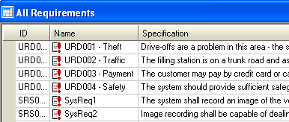
Layouts overview
Both Table Views and Matrix Views are based on Layouts
  The Requirement Table is a predefined Layout in SysML
  The Requirement Table layout defined a table with three columns:
    Name
    ID
    Specification
  The actual Table content came from the Scope of the Table

Slide 20

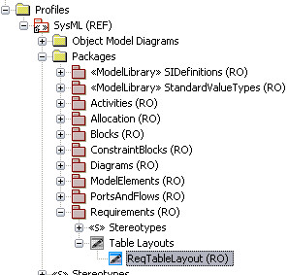
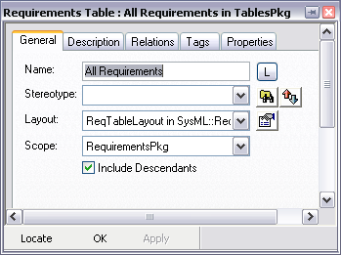
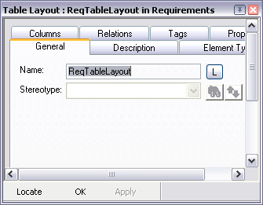
Locating the SysML layout
In the features view for the All Requirements table:
  Click Properties next to the Layout being used.
  Locate from the new Properties window.
Notes:
Course Title - Instructor Notes - Arial Narrow 20pt
Module X - Module Title

Slide 21
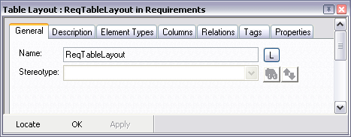
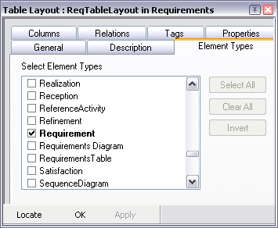
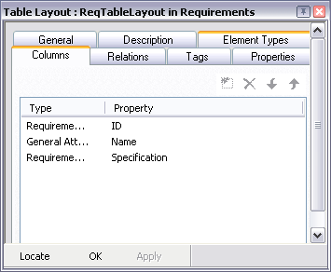
Layout features
A Table Layout must define
  Which element types to include (rows)
  Which pieces of information about those elements to include (columns)
Notes:
Course Title - Instructor Notes - Arial Narrow 20pt
Module X - Module Title

Slide 22
IBM Rational Rhapsody Advanced Systems Training v7.5
Defining a Layout

Slide 23
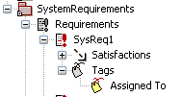
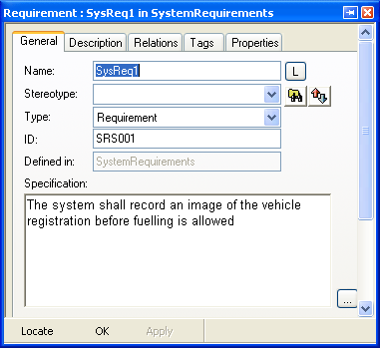
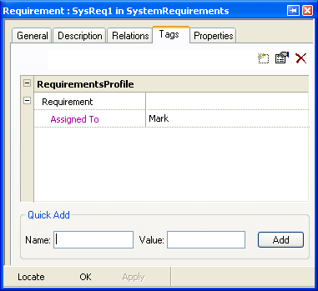
Overview
You will now define your own Table Layout for a table which contains Requirements.
  The columns for the Table will be:
    The Requirement ID
    The Requirement name
    The value of the Assigned To tag for the Requirement

Slide 24
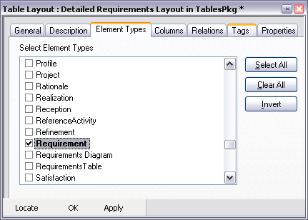

Defining a table layout
Right-click the TablesPkg:
  Select Add New → UML → Table Layout.
  Invoke its features.
  Change the name to Detailed Requirements Layout.
  Right-click the new Table Layout and select Features.
    On the Element Types tab, select Requirement.
Notes:
Course Title - Instructor Notes - Arial Narrow 20pt
Module X - Module Title

Slide 25
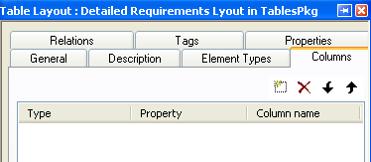
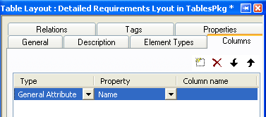
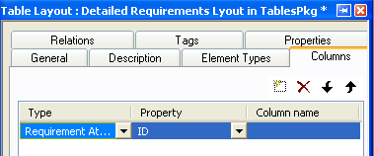
Defining the ID column
Select the columns tab
  Click New to add a column
  In the Type combo box
    Select Requirement Attribute
    (Only Requirements have IDs)
  In the Property combo box
    ID is already selected

Slide 26
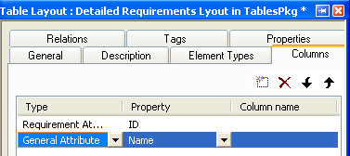
Defining the name column
Click New to add a column
  In the Type combo box
    Select General Attribute
    (All model elements have names)
  In the Property combo box
    Name is already selected

Slide 27
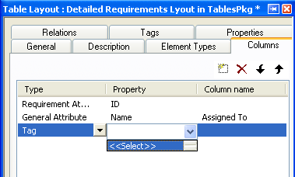
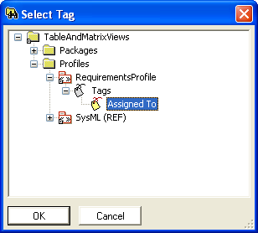
Defining the Tag column
Click New to add a column
  In the Type combo box
    Select Tag
  In the Property combo box
    Select <<Select>>
    In the mini-browser, select the Assigned To Tag in the Requirements Profile
    Click OK

Slide 28
IBM Rational Rhapsody Advanced Systems Training v7.5
Defining a Table View

Slide 29
Table Views - overview
When defining a Table View you must specify:
  The Layout on which to base the Table View
    Determine what columns of data you want
  The scope of the Table View
    The scope will populate the table with actual model element data
Note that when using the predefined SysML View – the Layout was predefined
  You still had to supply the scope

Slide 30
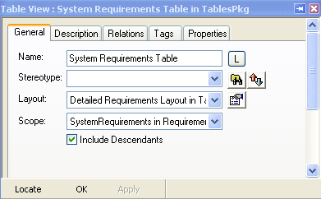
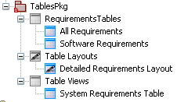
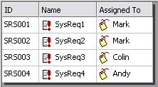
Add a new Table View
Right-click the TablesPkg:
  Select Add New → UML → Table View.
  Modify its features:
    Name it System Requirements Table.
    Set the layout to Detailed Requirements Layout.
    Scope the view to SystemRequirements
  Double-click the View to open it.
Notes:
Course Title - Instructor Notes - Arial Narrow 20pt
Module X - Module Title

Slide 31
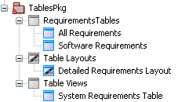
Table Views and Table Layouts in the browser
Note where Table Layouts and Table Views appear in the browser
Table Views based on a predefined layout
Custom Table Layouts
Table Views based on custom layouts

Slide 32
IBM Rational Rhapsody Advanced Systems Training v7.5
Matrix Views

Slide 33

Matrix Layouts - overview
Matrix Views are added in the same way as Tables
  Matrix Views are based on Matrix Layouts
Matrix Layouts are slightly more complex
When defining a Matrix Layout you must specify:
  From Element Types
    Left hand Column
  To Element Types
    Top Row
  Cell Element Types
    Center Cells
To
From
Cells
Notes:
Course Title - Instructor Notes - Arial Narrow 20pt
Module X - Module Title

Slide 34
Matrix Views - overview
When defining a Matrix View you must specify:
  Which Matrix Layout to base the Matrix on
  The from scope
  The to scope
To scope
From scope
Notes:
Course Title - Instructor Notes - Arial Narrow 20pt
Module X - Module Title

Slide 35

Add a new package
Add a new Package at the project level
  Name it MatrixPkg

Slide 36
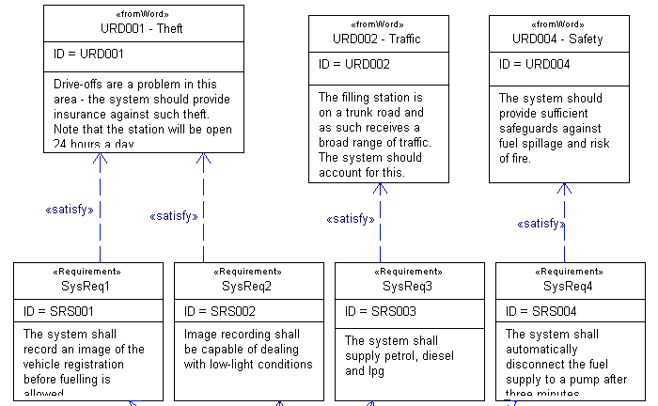

Matrix overview
You will now define a Matrix that displays any <<Satisfaction>> dependencies between Requirements in the model
  In this model you have System Requirements satisfying Stakeholder Requirements
    Note that the Requirements are in different Packages – this will become important when you select the scope of the Matrix
Stakeholder Requirements
System Requirements

Slide 37
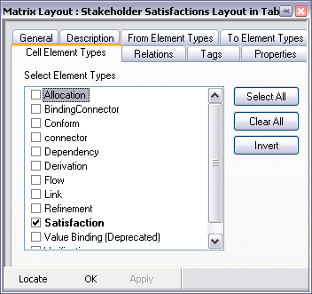
Defining Matrix Layouts
Right-click MatrixPkg:
  Select Add New → UML → Matrix Layout.
  Name it Stakeholder Satisfactions Layout
  In the features view:
    On the From Element Types tab, select Requirement.
    On the To Element Types tab, select Requirement.
    On the Cell Element Types tab, select Satisfaction.
    Click Apply.
Notes:
Course Title - Instructor Notes - Arial Narrow 20pt
Module X - Module Title

Slide 38
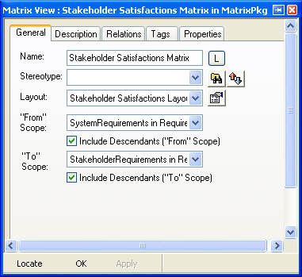
Adding a Matrix View
Right-click MatrixPkg:
  Select Add New > UML > Matrix View.
  Name it Stakeholder Satisfactions Matrix.
    Select Stakeholder Satisfactions Layout as the Layout
    Select System Requirements as the From Scope
    Select StakeholderRequirements as the To Scope
Notes:
Course Title - Instructor Notes - Arial Narrow 20pt
Module X - Module Title

Slide 39
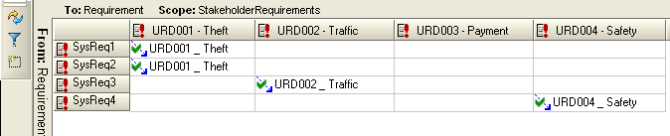
Open the Matrix View
Double-click the Matrix View to open it
  Where system Requirements satisfy user Requirements can now be seen in a Matrix view
Refresh
All of the cells are context-sensitive.
Toggle display of empty columns
Add new model elements to the ‘from’ or ‘to’ scope
Notes:
Course Title - Instructor Notes - Arial Narrow 20pt
Module X - Module Title

Slide 40
Adding new relations using the Matrix View
Right-click inside an empty cell on the Matrix View
  Select Add New Relation
  A new dependency stereotyped <<satisfy>> is added into the model
  Note that multiple selection also works

Slide 41
IBM Rational Rhapsody Advanced Systems Training v7.5
Matrix Views - Exercise

Slide 42
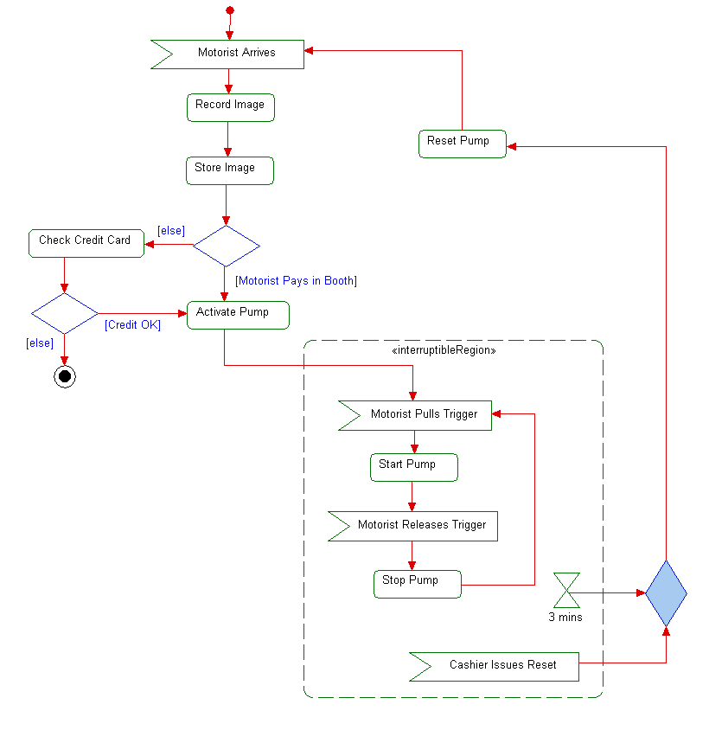
Exercise model
Open the Exercise model
  The model contains an Activity Diagram
  Each action has been allocated to a piece of architecture using an <<allocate>> dependency
    Note that this cannot be done graphically

Slide 43
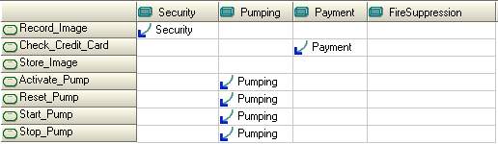
Exercise
Define a new Matrix View showing the allocation of Actions to Blocks.
  One of the Actions has not been allocated – use the generated Matrix to add an allocation
Notes:
  The Activity Model is in the UseCaseAnalysisPkg
  When defining your Matrix Layout – use State – not Action
  The Blocks can be found in the SystemArchitecturePkg

Slide 44
Summary
You have now learned:
  How to use the predefined Table Layouts in SysML
  How to define your own Layouts for Tables and Matrix Views
  How to define actual Tables and Matrix views that display model data
  How to use Tables and Matrix views to add new model elements and relations

